Slide 1

9 LEGENDS ENTERTAINMENT
www.9legends.in

Slide 2


About 9 Legends Entertainment:
Our goal is to always find the best solution for our customers to maximize their profit. Hence, our services are based on honesty, transparency, security and professionalism. To be the most preferred business group in the market place by operating within boundaries of ethics, compliance and integrity.
We are providing earning for our members to view video through our application.

Slide 3

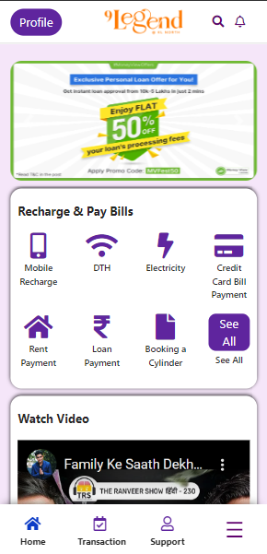

Slide 4





Slide 5



BOOK & EARN

Slide 6




MINIMUM FRANCHISEE FEES
5000/-

Slide 7


GOLD FRANCHISEE
0.75% ON EVERY VIDEO
5,000 to 40,000

Slide 8

DIAMOND FRANCHISEE
1% ON EVERY VIDEO
45,000 to 1,00,000

Slide 9

WATCH VIDEO & EARN
1 Advertisement is viewed 0.75% income will be generated everyday.

Slide 10
WATCH VIDEO & EARN
Direct Spot Income 2% ( Only Direct Sponsor)

Slide 11

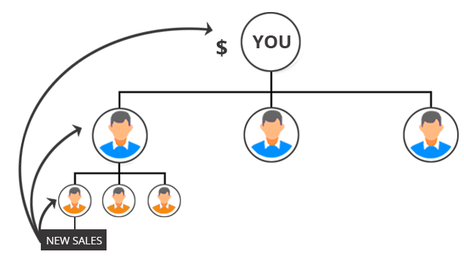
Level Income ( Every Month )
Level | Commission
1st level | 0.60%
2nd to 6th level | 0.30%
7th to 12 level | 0.15%

Slide 12

ASSOCIATE REGULAR INCOME
DESIGNATION | TARGETS | MONTHLY INCENTIVE | T.A | HOUSE FUND | CAR FUND | TOTAL
EXECUTIVE | 2 LAKH | 1.000 | 1.000 |  |  | 2,000
SR. EXECUTIVE | 5 LAKH | 3.000 | 1.000 | 1.000 |  | 5,000
SR. EXECUTIVE-1 | 12 LAKH | 5.000 | 2.000 | 2.000 | 1.000 | 10.000
SR EXECUTIVE-2 | 25 LAKH | 10.000 | 4.000 | 4.000 | 2.000 | 20,000
DEVELOPER | 52 LAKH | 15.000 | 7.000 | 7.000 | 5.000 | 34,000
SR DEVELOPER | 1.05 CR | 25.000 | 20.000 | 20.000 | 20.000 | 85,000
SR DEVELOPER-1 | 2.25 CR | 50.000 | 40.000 | 40.000 | 40.000 | 1,70,000
CO-ORDINATOR | 5.10 CR | 1,00,000A | 80,000 | 80,000 | 1,00,000 | 3,60,000
SR –ORDINATOR | 10.10 CR | 2,50,000 | 1,50,000 | 1,50,000 | 2,00,000 | 7,50,000
CHIEF CO-ORDINATOR | 20.25 CR | 4,00,000 | 2,00,000 | 2,00,000 | 3,50,000 | 11,50,000
CHIEF CO- ORDINATOR -1 | 50 CR | 6,00,000 | 3,00,000 | 3,00,000 | 5,50,000 | 17,50,000
CHIEF CO- ORDINATOR-2 | 100 CR | 8,00,000 | 4,00,000 | 4,00,000 | 7,50,000 | 23,50,000

Slide 13

AFTER COMPLETION OF CHIEF CO-ORDINATOR 2 , HE/SHE WILL BE ELIGIBLE FOR ROYALTY INCOME.
ACHIEVERS WILL GET 2% OF ROYALT INCOME ON COMPANIES TURNOVER AMONG THE ACHIEVERS.

Slide 14


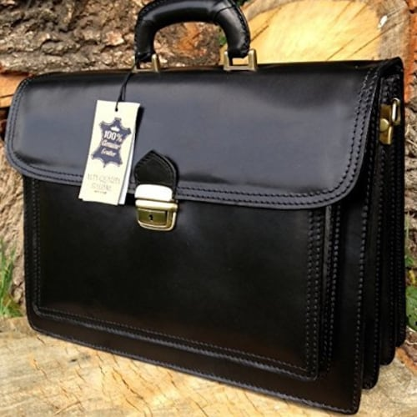

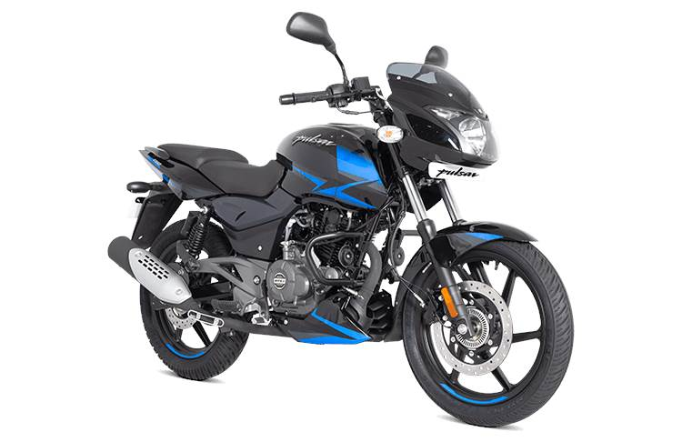
NEW LEVEL ACHIEVE REWARD
SR. EXECUTIVE-OFFICE PORTFOLIO BAG
SR.EXECUTIVE-1
SMART PHONE
SR. EXECUTIVE-2
LAPTOP
DEVELOPER
150 CC
BAJAJ PULSAR

Slide 15

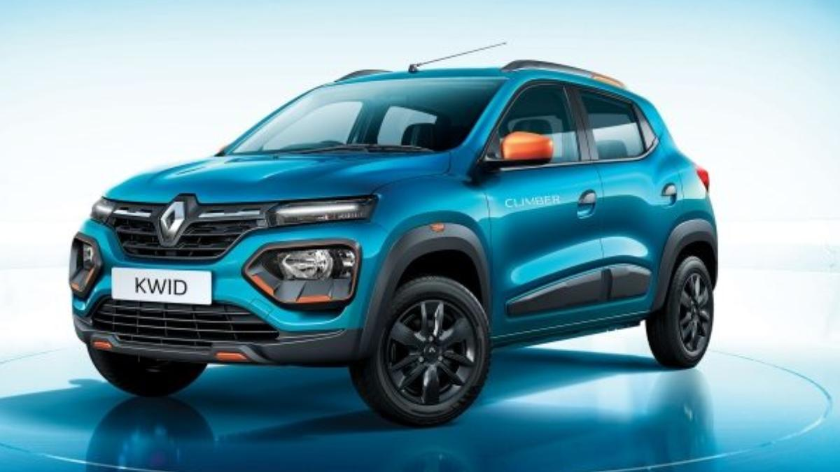

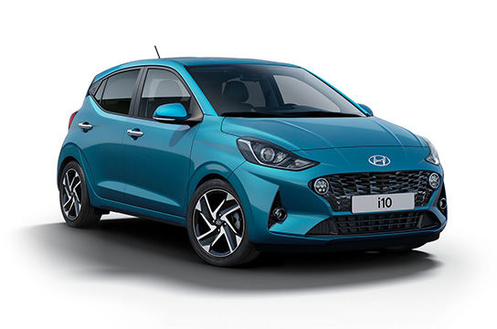
NEW LEVEL ACHIEVE REWARD
SR. DEVELOPER
ROYAL ENFIELD
SR. DEVELOPER -1
RENAULT KWID
SR. CO-ORDINATOR
TATA NEXON
CO-ORDINATOR
HYUNDAI i10

Slide 16


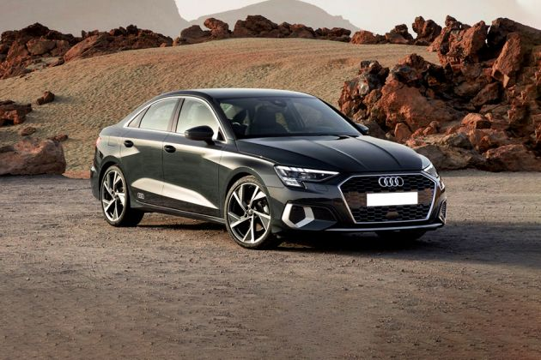
NEW LEVEL ACHIEVE REWARD
CHIEF- CO ORDINATOR
MAHINDRA SUV
CHIEF –CO ORDINATOR -1
TOYOTA FORTUNER
CHIEF –CO ORDINATOR -2
AUDI A3

Slide 17


